Slide 1
NLP and Text mining
Amr MOHAMED
mohamedamr@cy-tech.fr

Slide 2
Introduction
Over the past decade, Text Mining and NLP have been very hot topics in the tech field because of they have solved an important problem which is how to get insights from text. In this presentation, we are going to go through the procedure of Text Mining on 50 theses that were conducted in France and identifying the similarities between the theses text. In addition, we will see how we can use sentences to create linguistic exercises using a technique called POS-tagging,

Slide 3
Text Mining and doctoral dissertations

Slide 4
Web Scraping the Theses pdf files and TXT conversion
Web scraper was built using the libraries:
requests
Beautiful Soup
50 theses PDF files were scraped.
The theses PDF files were converted to TXT files using the library pdftotext

Slide 5
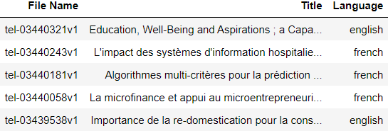
Theses language detection
NLTK library was used to identify the languages of the theses using stop words.
We got that the 50 theses consisted of theses of 4 different languages: English, French, Romanian, and Portuguese
Sample of language detection output for theses

Slide 6
term frequency–inverse document frequency (TF-IDF)
TF-IDF is a method used in identifying the importance of a document in a set of documents or a corpus.
Its major advantage is that it quantifies words and documents using vectorization, so we can perform multiple tasks such as finding the relevant documents, ranking, and clustering.
TF-IDF = Term Frequency (TF) * Inverse Document Frequency (IDF) where Term Frequency is the frequency of a word in a document and the Document frequency is the frequency of documents having a specific term.

Slide 7
term frequency–inverse document frequency (TF-IDF)
TF-IDF was performed on the 50 TXT files using scikit-learn’s TfidfVectorizer.
We chose the highest 5 words in TF-IDF of each document.
We can see from the table below that the document tel-01689242 is mainly concerned about libraries through the TF-IDF of the 5 words of the highest TF-IDF from the document.

Slide 8
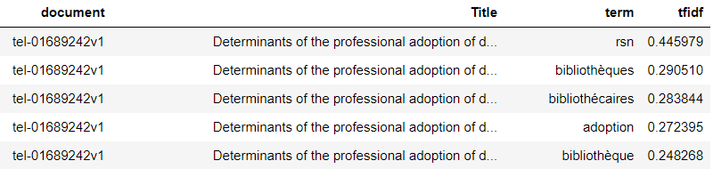
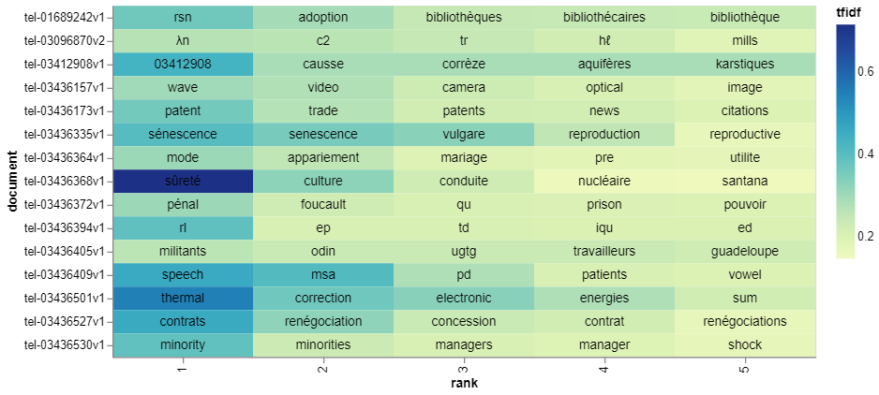
term frequency–inverse document frequency (TF-IDF)
Tel-01689242 document output of TF-IDF
Top 5 ranked words by high TF-IDF for each document

Slide 9
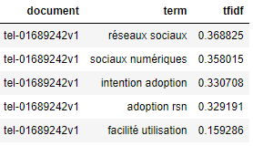
Bigram
We used sklearn’s TfidfVectorizer to get the bigrams (two-word sequence of words) across the documents.
We found, on average, higher TF-IDF values for the bigrams than unigrams.
Tel-01689242 document output of bigrams TF-IDF

Slide 10
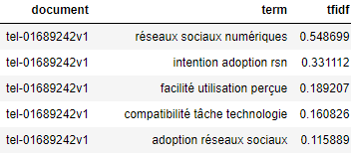
Trigram
We used sklearn’s TfidfVectorizer to get the trigrams (Three-word sequence of words) across the documents.
We found, on average, surprisingly higher TF-IDF values for the Trigrams than for unigrams and for bigrams.
Tel-01689242 document output of Trigrams TF-IDF

Slide 11
Cosine similarity
Cosine similarity is a metric that gives a useful measure of how similar two documents are likely to be in terms of their subject matter.
We used sklearn’s linear_kernel to calculate the cosine similarities between 10 theses text files that were selected in advance.
We obtained a 10x10 matrix that clarifies the similarity between each document and the 9 other documents.

Slide 12
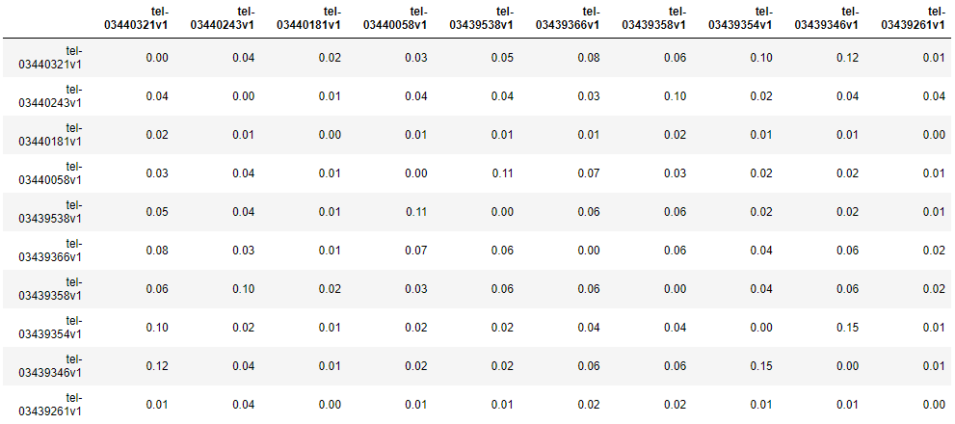
Cosine Similarity Matrix
Cosine similarity matrix for 10 selected theses

Slide 13
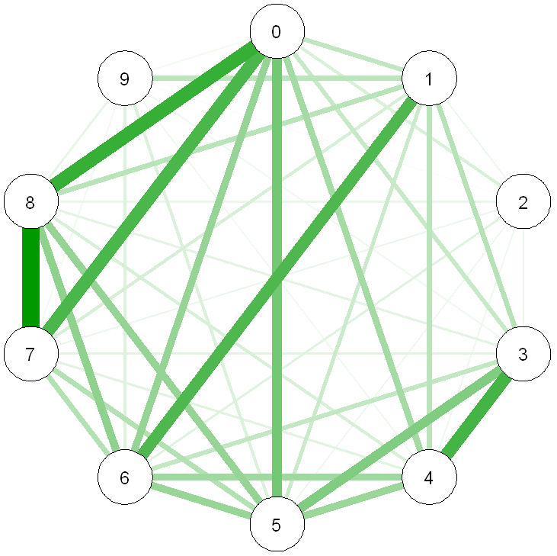
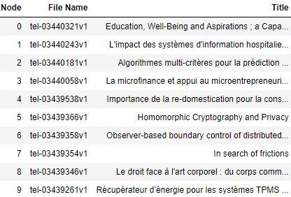
Cosine similarity
We can see from the graph of the matrix, that documents 0,7,and 8 are very similar to each other, we can also see that 1 is similar to 6, and that 3 is related to 4 and vice versa.
Cosine similarity matrix for 10 selected theses

Slide 14
POS-tagging and exercise generation

Slide 15
Methods
We used a corpus of 7000 Arabic sentences.
Stanza library for python was used for POS-tagging the sentences and identifying the different POS-tags.
Packages qutrub and libqutrub were used in conjugating the Arabic verbs with all the different pronouns and in all the required tenses.

Slide 16
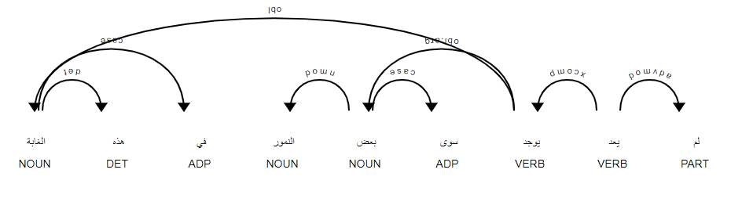
Pos-tagging
Stanza library was used to identify the different parts of speech in the sentences.
Displacy’s visualization of Stanza’s POS-tagging

Slide 17
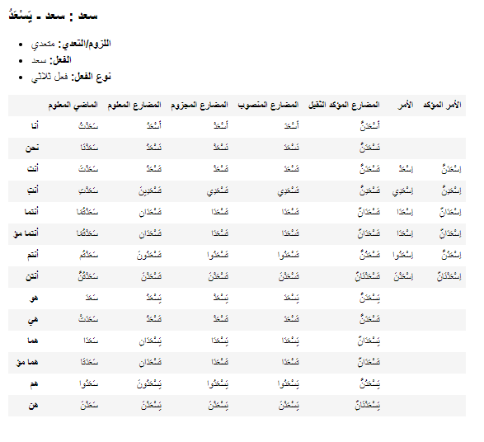
Verb conjugation
Library Libqutrub was used to conjugate the Arabic verbs in all the different tenses by specifying the lemma of the verb.
Libqutrub verb conjugation

Slide 18
Exercise creation
To create the exercises, we specified the type of exercise such as:
Vocabulary
Grammar
then we identified the desired word of the sentence on which the exercise to
be made.

Slide 19

Exercise creation
Arabic verb conjugation exercise

Slide 20
Exercise Database creation
A database was created to save the exercises where each exercise is identified by:
Exercise type (ex: MCQ).
Exercise objective (ex: verb conjugation).
Exercise Focus (ex: gender identification).
Exercise ID.
Exercise format (text or audio).
Sentence: the sentence from which the exercise is created.
Source language: the language of the learner.
Target language: the language that is taught(i.e: Arabic).
Instruction: instruction to identify the exercise for the user.
Right answer.
The 3 distractors (wrong answers).

